Slide 1



Slide 2

Real Time Colour and Object detection
Supervised by:
Ms. Sadia Ejaz
Group Members:
Aqeela Sultan (Fa17-BCS-072)
Ayesha Nawaz(FA17-BCS-088)
Department of Computer Science
COMSATS University Islamabad, Attock Campus

Slide 3
Outline
Introduction
Working Flow
Problem statement
Objectives
Interface
Modern tools
Benefits
References
______________

Slide 4
Introduction
Object detection is a largely forthcoming scope for detecting object using machine learning methods which are used for social and industrial applications.
Color is a feature that has been heavily exploited in digital image processing, as it is a powerful tool that often facilitates the classification and identification of objects.
Android utility is very easy, handy, portable and fantastic in use.
One can detect the object in an image/Camera View and Also know about the color of the object via text labelling or voice.
_______________________________

Slide 5
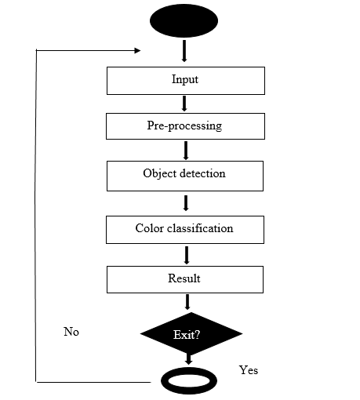
Working flow
_______________________________

Slide 6
Problem statement
Multiple external devices and mobile applications used for object or color detection.
low vision user unable to read text labelling on screen.
The main problem if low vision and color blind user wants to recognize an object than how he/she will do it? By downloading multiple android apps for multiple purpose which is not the effective way and resources and a lot effort required.
_______________________________

Slide 7
Objectives
To dispose the need of dedicated gadgets, different wearable devices and also multiple use of android application.
To provide an application to the users to overcome visual disabilities.
To improve each day lives of color blind and people with low vision and hearing.
_______________________________

Slide 8
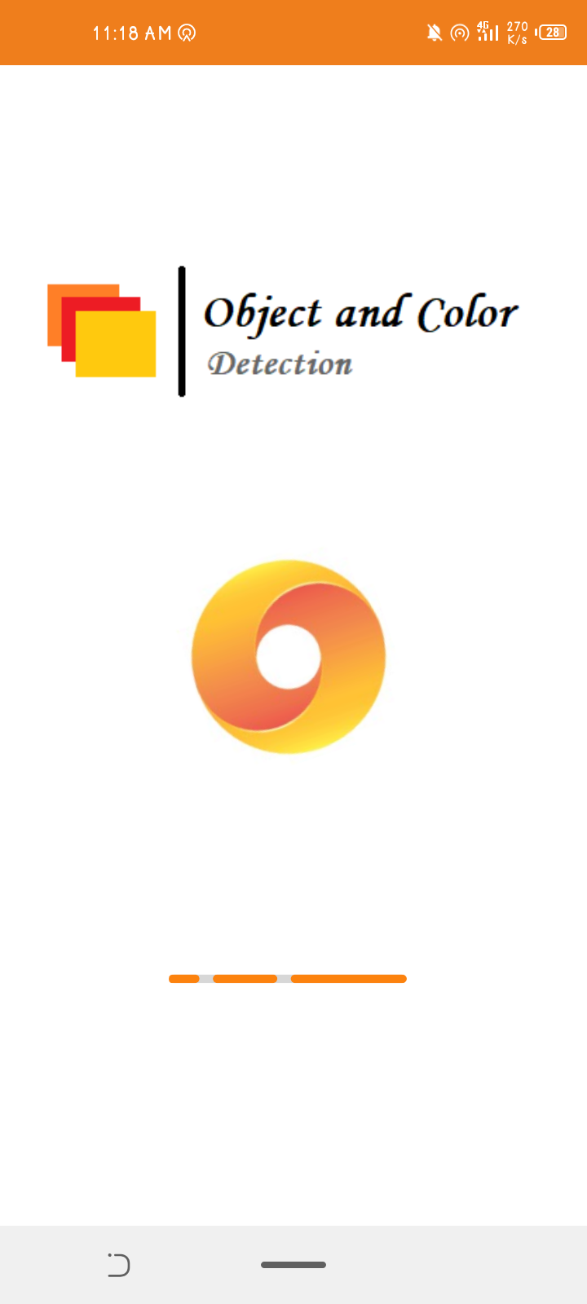
Interface
User can easily start the application
For object and its color detection purpose.
User can detect things in real time camera view.
And also can import image from gallery for detection purpose.
_______________________________

Slide 9
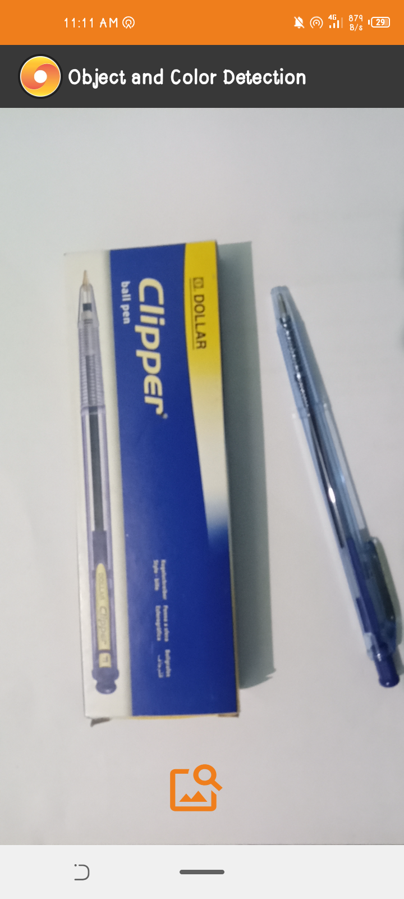
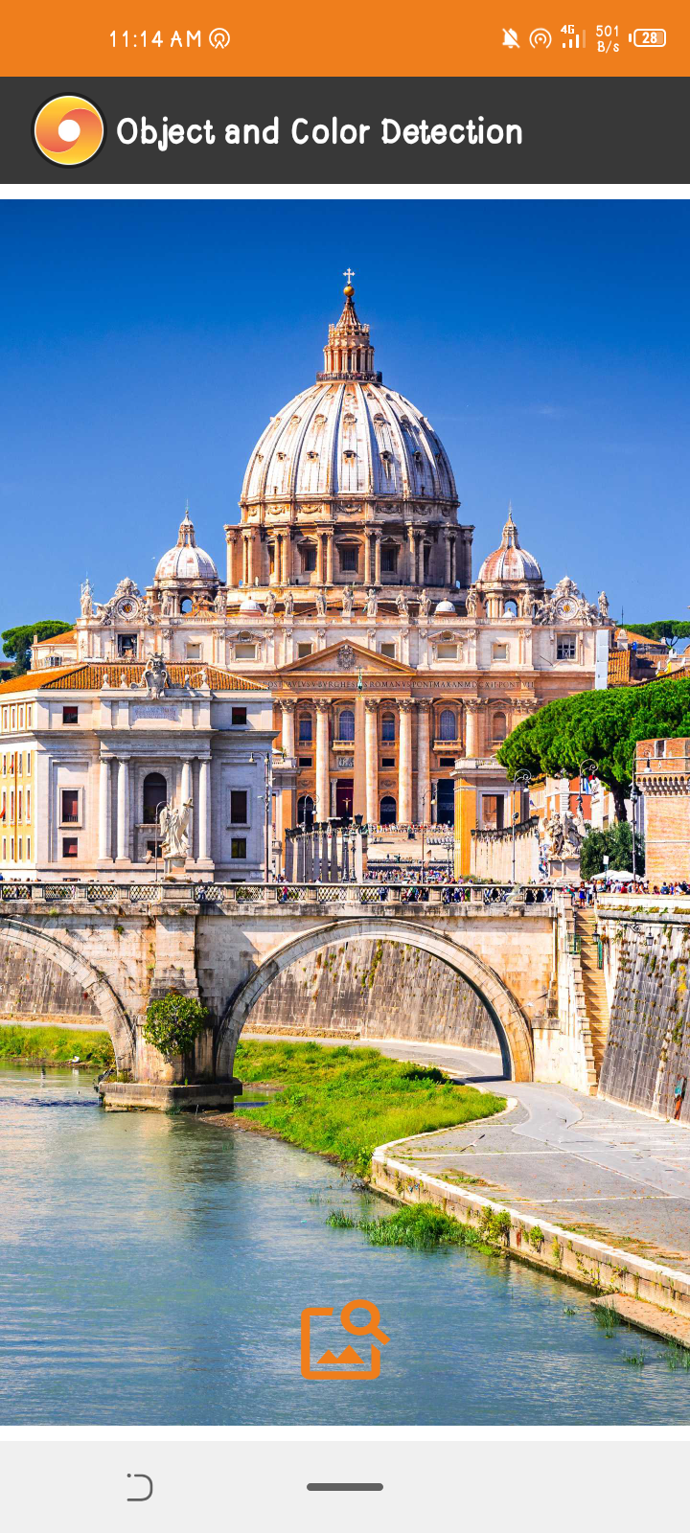
Import Image
Camera View
_______________________________

Slide 10
Modern tools
Software Requirements dependence:
IDE: Android Studio 4.0.1
Programming language: Python, Java, XML
Database: Firebase
Tools: Android Studio, IDLE ( python 3.6)
Hardware Requirements dependence:
Smart Mobile Phone
_______________________________

Slide 11
Benefits
The output is in verbal form to provide users with disabilities with the concept of detected objects and colors.
To save efforts ,resources and money by using this application.
Learning perspective
_______________________________

Slide 12
References
http://cs229.stanford.edu/proj2016/report/GongHeYang-Real-time%20Object%20Detection-report
https://www.divaportal.org/smash/get/diva2:1311057/FULLTEXT01
https://data-flair.training/blogs/project-in-python-colour-detection
_______________________________

Slide 13
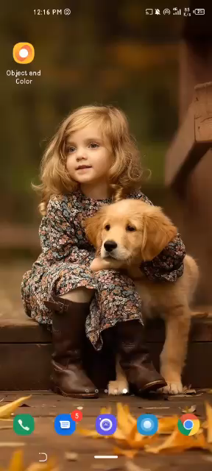
Demo

